Slide 1
Credit Risk Management
Sathya Narayanan K

Slide 2
Details of the project :
Dataset Overview
Train Data Volume | 80K
Test Data Volume | 20K
Type of Problem | Classification

Slide 3
TABLE OF CONTENTS
01
02
03
About the project
To assess the credit risk for the profile and decide whether the loan would be Fully Paid or Charged-off
Major requirements
To understand more on the different fields in the dataset and analyze the same to apply the preprocessing and modeling
Project goals
To find the result of test data and compare with the Actual Data

Slide 4

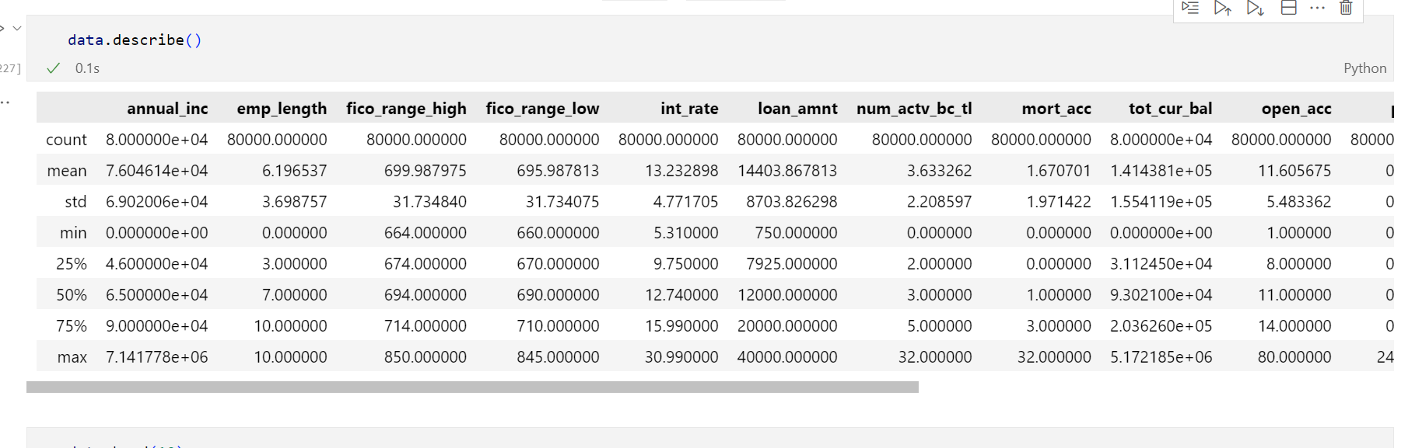
Understanding the Data

Slide 5
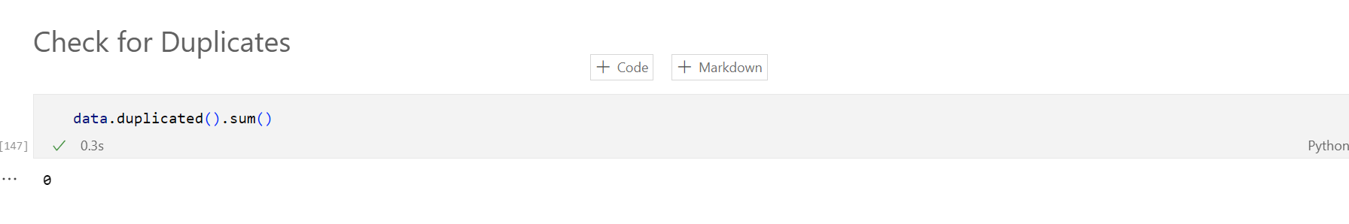
Understanding the Data
Inference : No any Duplicates Found

Slide 6
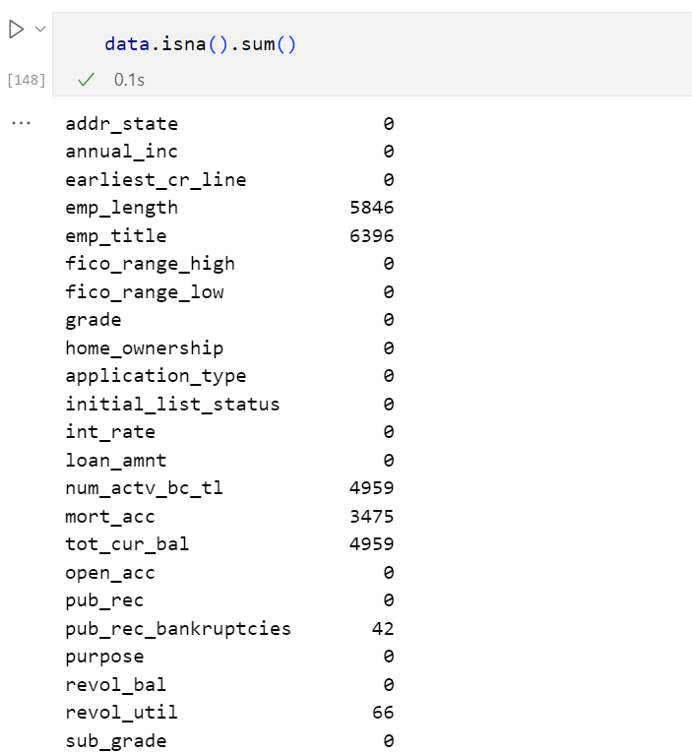
NA Check
Inference : NA handling to be Performed

Slide 7
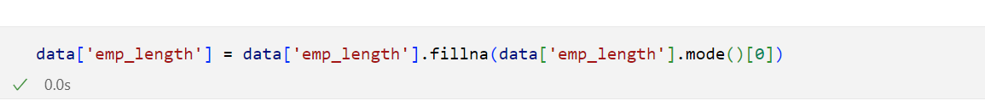
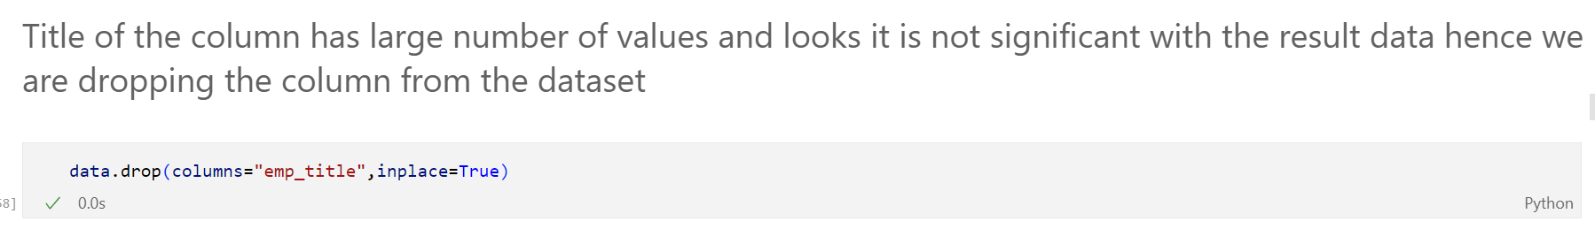
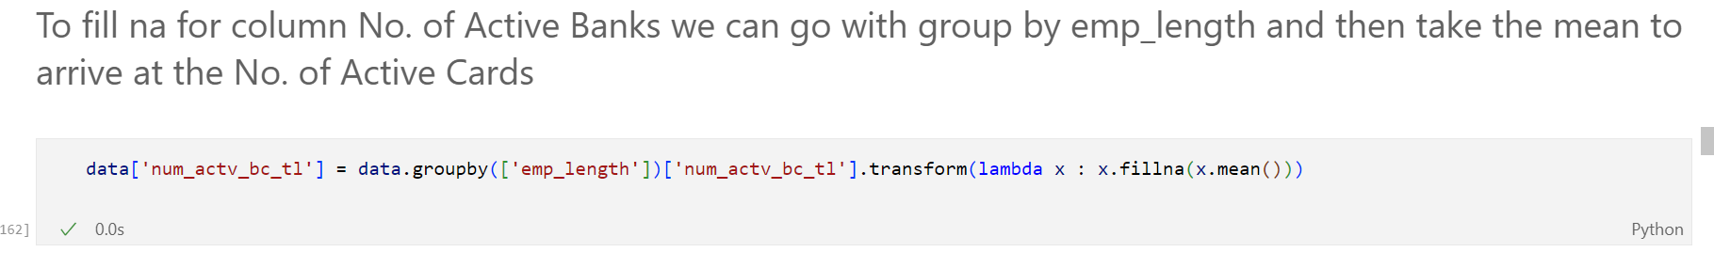
Fixing NA
\

Slide 8
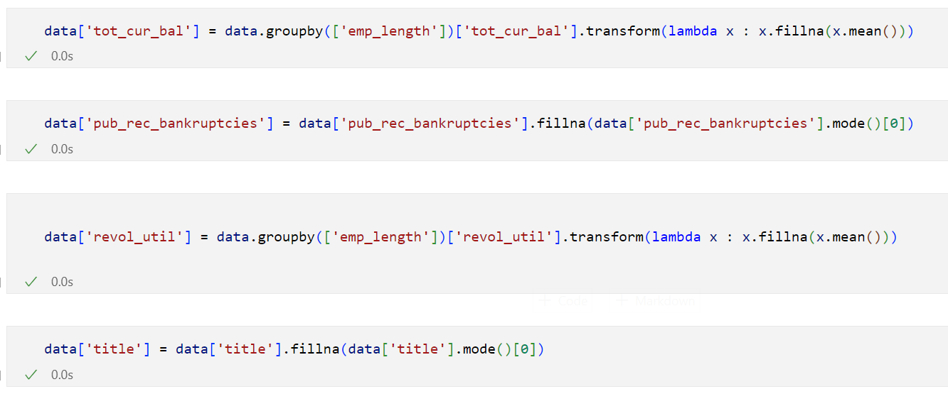

Slide 9
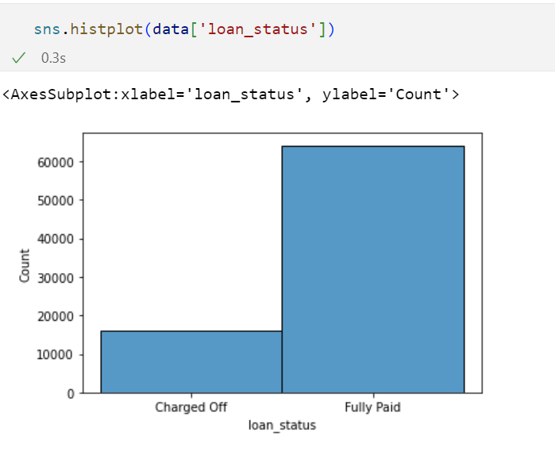
Analysis of data
Analysis of the Input Data

Slide 10
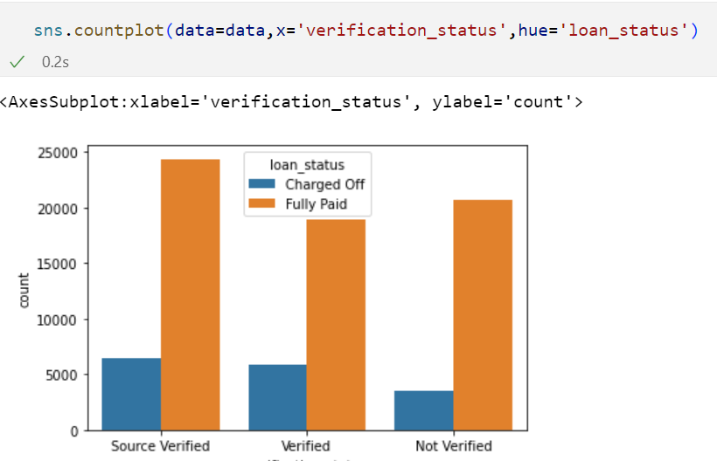
Analysis of data
Analysis of the Input Data

Slide 11
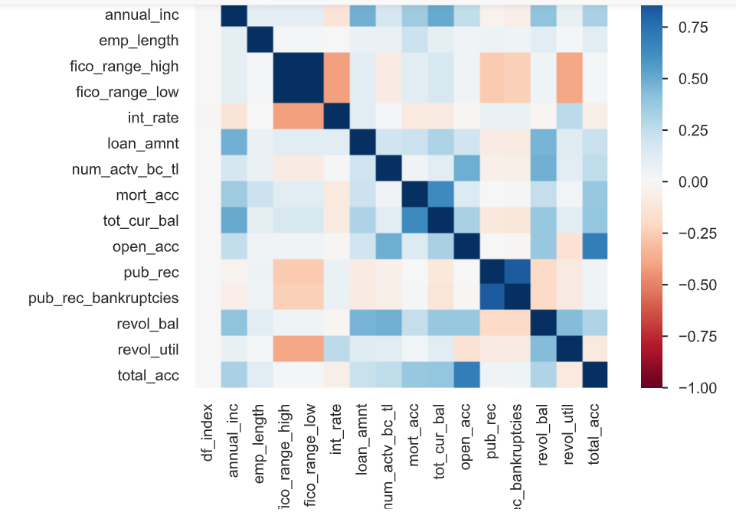
Analysis of data
Analysis of the Input Data

Slide 12
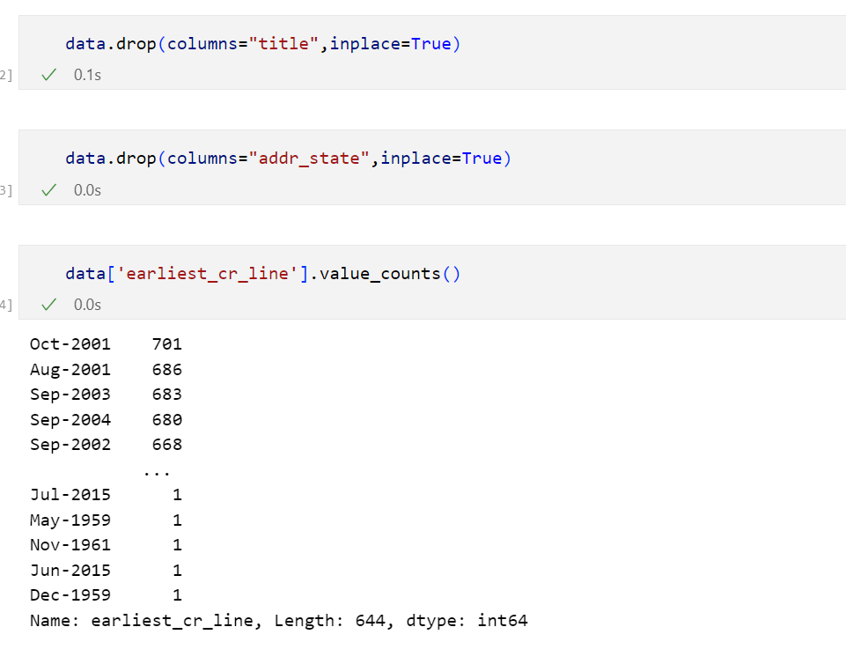
Analysis of data
PreProcessing

Slide 13
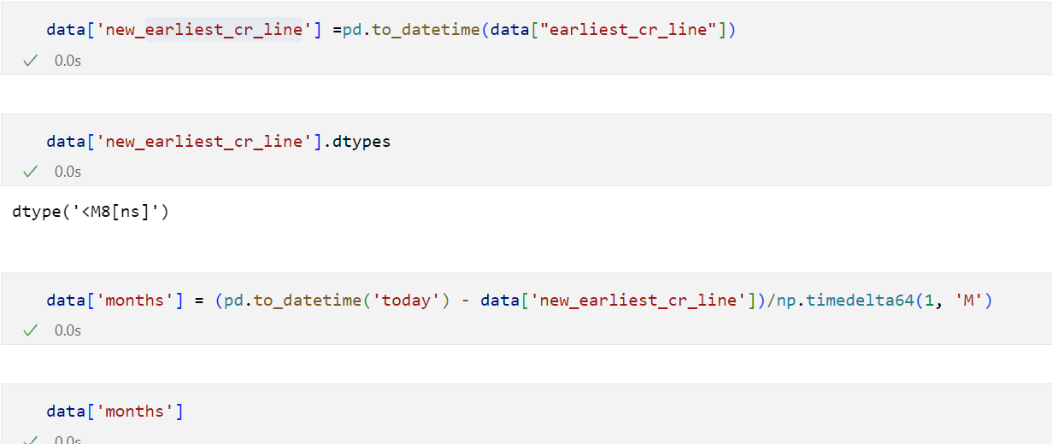
Analysis of data
PreProcessing
Modification of earliest_cr_line Column

Slide 14
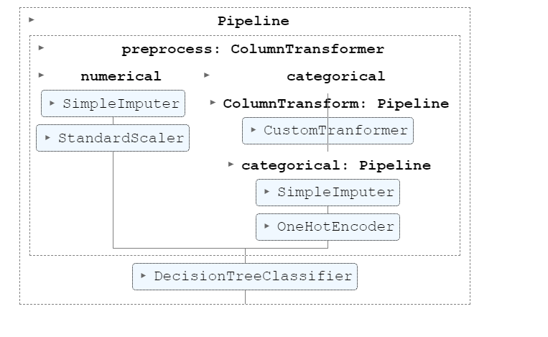
Analysis of data
PreProcessing

Slide 15
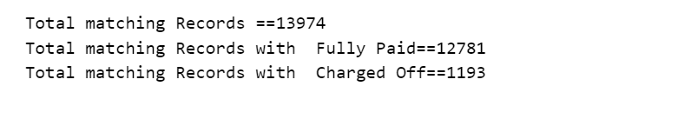
Analysis of data
Result by comparing the Results with the Actuals
Note : Algorithm Used : Decision Tree
For Categorical Columns used Simple Imputer and One Hot Encoding
For Numerical Columns used Simple Imputer and Standard Scaler

Slide 16
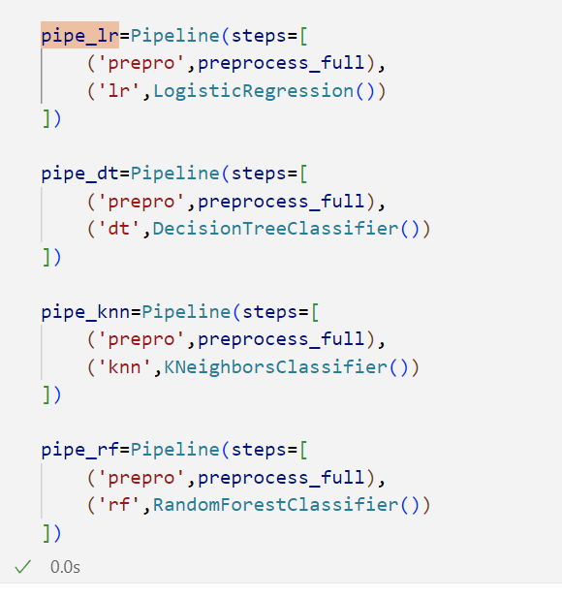
Analysis of data
Multi Model Run Comparison

Slide 17
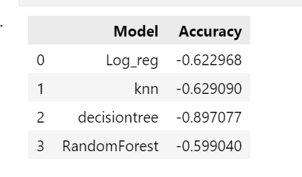
Analysis of data
Multi Model Run Comparison

Slide 18
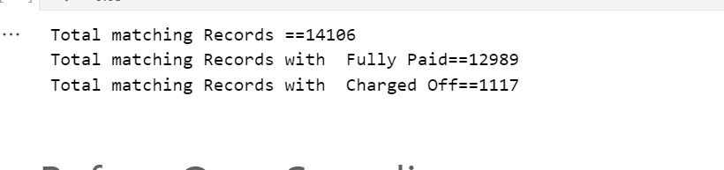
Analysis of data
Results post sampling with Decision Tree

Slide 19
Analysis of data
Thank you !

